Slide 1


The Center for Internet Security - Critical Controls
Security Basics On a Zero Dollar Budget
Rob VandenBrink
rob@coherentsecurity.com

Slide 2

Good Afternoon – whoami $me =
Rob VandenBrink, Coherentsecurity.com
In the industry since mainframe / PC1 / DOS 1.0 days (1981)
Blog at the Internet Storm Centre (https://isc.sans.edu)
Editor for Center for some CIS Security Benchmarks: Palo Alto, Cisco Nexus, Cisco FirePower
$dayjob?
Networking, Virtualization, Security and Automation / Orchestration.
Design, Build, Fix, Audit, Attack, Defend

Slide 3
CIS Critical Controls
20 Critical Controls that highlight how Blue Teams can better secure most environments. https://www.cisecurity.org/controls/
Hundreds of sub-controls under the 20 (great reference at https://www.auditscripts.com/download/4229/ )
More or less independent of Operating System or Vendor
Roughly in order of impact
Today we’ll cover off how several of these controls can be used to secure an organisation, focusing on using PowerShell to deliver

Slide 4
CIS Critical Controls – “Basic” Controls
Covering the basic controls generally means that your organization is no longer the slowest gazelle in the herd
This is the “If you are not doing this, you should start” list
Hardware Inventory
Software Inventory
Continuous Vulnerability Management
Control Admin Rights
Set Secure Configuration Templates for Servers, Workstations, Laptops, Mobile
Logging

Slide 5
CIS Critical Controls - Foundational
The Best Practices/ Smart Move list:
Email and Browser Protections
Malware Defenses
Limit Network Ports, Protocols and Services (network segmentation)
Data Recovery Capabilities
Secure config for Network Devices – Firewalls, Routers, Switches etc
Boundary Defense
Data Protection
Controlled Access (Need to Know)
Wireless Access Control
Account Monitoring

Slide 6
CIS Critical Controls - Organizational
This list focuses more on people and processes
These tend to involve training, transitioning or hiring people ($BUDGET)
More difficult and slower to implement in most organizations
Security Awareness Training
Application Software Security
Incident Response
Penetration Test / Red Team Exercises (Threat Hunting)

Slide 7

CC#1 – Hardware Inventory
Easy to inventory hardware in AD – PowerShell is your friend
You can’t protect / patch / backup what you don’t know is there
Adding an NMAP scan allows you to inventory non-AD components, or at least get a start on that
Looking ahead to controls down the list – keeping Student / Guest / SCADA / ICS / Medical Equipment networks segregated and firewalled away from production makes this much easier!
Active scanning Student / Guest owned gear legal issues
Scanning Medical gear in particular = liability issues

Slide 8
CC#1 – Hardware Inventory
A one-liner in PowerShell, then dump to Excel, db or whatever
For many situations, no need to buy anything – “AD knows”:
Can also “loop” through AD member list (or a subnet for non-domain computers) and query hw directly with WMI
Unless you are creating a target list, inventorying EOL OS’s just feeds the dumpster fire (XP, S2K3, S2K8, W7)
# OS / Stale Computer Acct inventory from AD
$pcs = Get-ADComputer -filter * -property Name, OperatingSystem, OperatingSystemVersion, LastLogonDate, IPV4Address
$pcs | export-csv -path ./AD-OSInventory.csv

Slide 9
CC#1 – Hardware Inventory
For more (hw specific) inventory info, use “get-wmiobject”/ “gwmi”
Basic HW:
$computerhw = Get-WmiObject -Class Win32_ComputerSystem -ComputerName $Computer | select Name,Manufacturer, Model, SystemSKUNumber, TotalPhysicalMemory
CPU:
$computerCPU = gwmi win32_processor -ComputerName $Computer | select DeviceID,Name
OS:
$computerOS = gwmi Win32_OperatingSystem -ComputerName $Computer | select Version, Caption

Slide 10
CC#1 – Hardware Inventory
Memory
$computerRAM = gwmi Win32_PhysicalMemory -ComputerName $Computer | select DeviceLocator,Manufacturer,PartNumber,Capacity,Speed
$computertotalRAM = (gwmi Win32_PhysicalMemory | Measure-Object -Property capacity -Sum).sum /1gb
Disk:
$computerDisks = gwmi -Class Win32_LogicalDisk -Filter "DriveType=3" -ComputerName $Computer | select DeviceID,VolumeName,Size,FreeSpace

Slide 11
CC#1 – Hardware Inventory
Serial Number:
$computerBIOS = gwmi win32_bios -ComputerName $Computer
GPU:
$computerGPU = Get-WmiObject Win32_VideoController | Select description, driverversion, CurrentHorizontalResolution,CurrentVerticalResolution
Putting this all together (demo):

Slide 12
CC#2 – Software Inventory
Again, you can’t patch what you don’t know is out there
You can’t hunt down and delete things if you don’t know what is there (Java, Silverlight, Flash, Adobe PDF reader)
Yup, “KeyGen” / “Free” / “Jailbreak” often just means malware
You can get a decent software inventory across AD just with Powershell
You can also remotely delete offending software in Powershell

Slide 13
CC#2 – Software Inventory
Example collection script for standard Windows installs
Note the “are you there” check – this saves a bundle of time
Often collect CC1 and CC2 info together
Demo (sort by name and version for outlier versions or apps):
$pcs = get-adcomputer -filter * -property Name,OperatingSystem,Operatingsystemversion,LastLogonDate,IPV4Address
$patchinfo = @() ; $i=0
foreach ($pc in $pcs) {
$i+=1 ; write-host $i
if (Test-Connection -ComputerName $pc.DNSHostName -count 2 -Quiet) {
$appsonpc = Get-WmiObject -Class Win32_Product -computername $pc.DNSHostName | select pscomputername, vendor, name, version, installdate
$domainapps += $appsonpc
} }
$domainapps | export-csv -path ./domainapps.csv

Slide 14
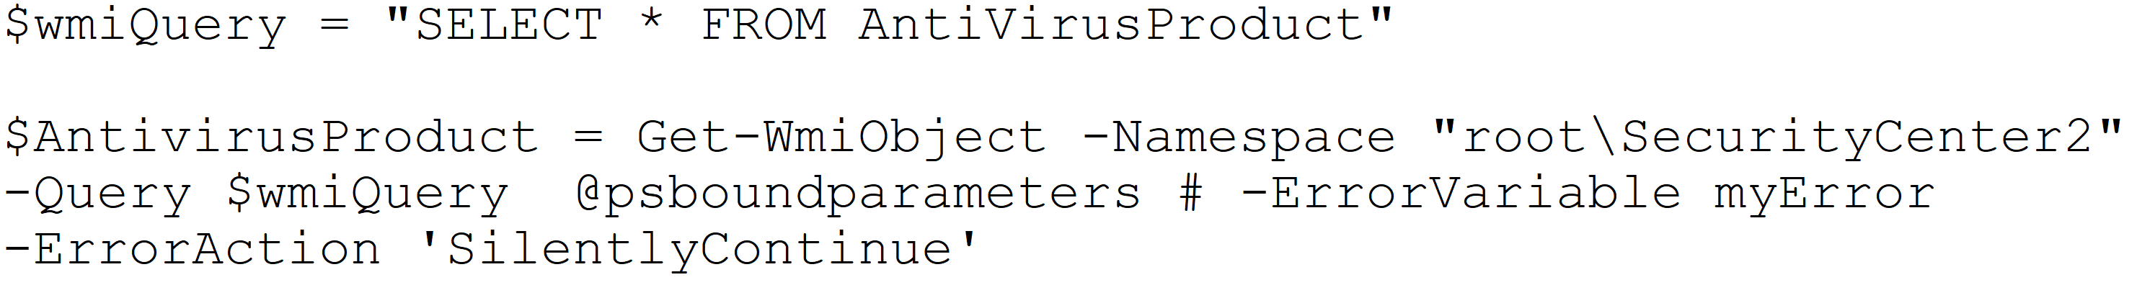
CC#2 – Software Inventory (Actually CC#8)
Special Case: Antivirus / Endpoint Protection app
WMI Query against the MS SecurityCenter2 namespace
Look for version mismatches, or user / helpdesk installed software
Again, “sort” is your friend!

Slide 15
CC#3 – Vulnerability Management
With hardware / software inventories done, time to patch
OS / MS Office patching is automated by default
Important because criminals have many patches reversed and incorporated into malware in days or even hours.
Usually the approach is a bit more structured than “let it just happen”:
On patch Tuesday, monitor news sources for issues (ISC Stormcast, vendor newsgroups etc)
On Wednesday, patch a representative group of pilot servers and workstations
Patch the rest of the workstations on Thursday
Progressively patch all servers, with completion by Saturday at the latest

Slide 16
CC#3 – Vulnerability Management - OS
To get “last patch date” (ie – which stations got missed?):
$pcs = get-adcomputer -filter * -property Name,OperatingSystem,Operatingsystemversion,LastLogonDate,IPV4Address
$patchinfo = @() ; $i=0
foreach ($pc in $pcs) {
$i+=1 ; write-host $i
if (Test-Connection -ComputerName $pc.DNSHostName -count 2 -Quiet) {
$tempval = new-object psobject
$lasthf = get-hotfix -computername $pc.dnshostname | sort InstalledOn | select -last 1
$tempval | add-member -membertype noteproperty -name Name -value $pc.dnshostname
$tempval | add-member -membertype noteproperty -name PatchDate -value $lasthf.installedon
$tempval | add-member -membertype noteproperty -name OperatingSystem -value $pc.OperatingSystem
$tempval | add-member -membertype noteproperty -name OperatingSystemVersion -value $pc.OperatingSystemVersion
$tempval | add-member -membertype noteproperty -name IpAddress -value $pc.IPV4Address
$tempval | add-member -membertype noteproperty -name LastLogonDate -value $pc.LastLogonDate
$patchinfo += $tempval
} }
$patchinfo | export-csv -path ./patchdate.csv

Slide 17
CC#3 / CC#11 – Infrastructure Patching / Vuln Mgt
Lots of infrastructure is outside of the “Servers & Workstations” pool
These often get missed in the patching policy:
Hypervisors
BladeCenters
Server Mgt such as rDRAC, iLo, BMC (web app vulns, default creds)
Backup Servers – often unpatched, frequently ransomwared (OUCH)
Storage Switches, SANs, Routers, Switches, Wireless
For instance, both if not patched Vmware vCenter and Cisco ISE are vulnerable to CVE 2017-5638 (think Equifax Breach)
https://isc.sans.edu/forums/diary/Struts+Vulnerability+CVE20175638+on+VMware+vCenter+the+Gift+that+Keeps+on+Giving/24606/

Slide 18
CC#3 – Vulnerability Management - Apps
Software Patching is tougher
MS Software can roll right into Windows Update of course
Other vendors (Adobe, Oracle, Apple) also publish on a regular schedule, and often can be automated within the app.
Software inventory will catch all the versions, but won’t highlight patch dates
This is where actual inventory software can help
Most orgs “have an app for that”

Slide 19
CC#3 – Vulnerability Management - Apps
Your “patch all the things” app will miss stuff
Tools like Nessus or OpenVAS can run authenticated scans
Can cross-check installed applications and configurations against known vulnerabilities
Tools like Burp Suite or ZAP can be configured to assess web apps or web app component versions
For example, old versions of jquery, dijits, struts, Django, Wordpress, Wordpress Plugins should pop right up
Problems like this result in websites getting compromised at scale

Slide 20
CC4 – Admin Rights / CC 16-Account Monitoring
Got Admins?
$b = @()
$a = $()
'Domain Admins', 'Administrators', 'Enterprise Admins', 'Schema Admins', 'Server Operators', 'Backup Operators' | ForEach-Object {
$groupName = $_
$a = Get-ADGroupMember -Identity $_ -Recursive | Get-ADUser | Select-Object Name, samaccountname, DisplayName, @{n='GroupName';e={ $groupName }}
$b += $a
}
$b | export-csv alladmins.csv

Slide 21
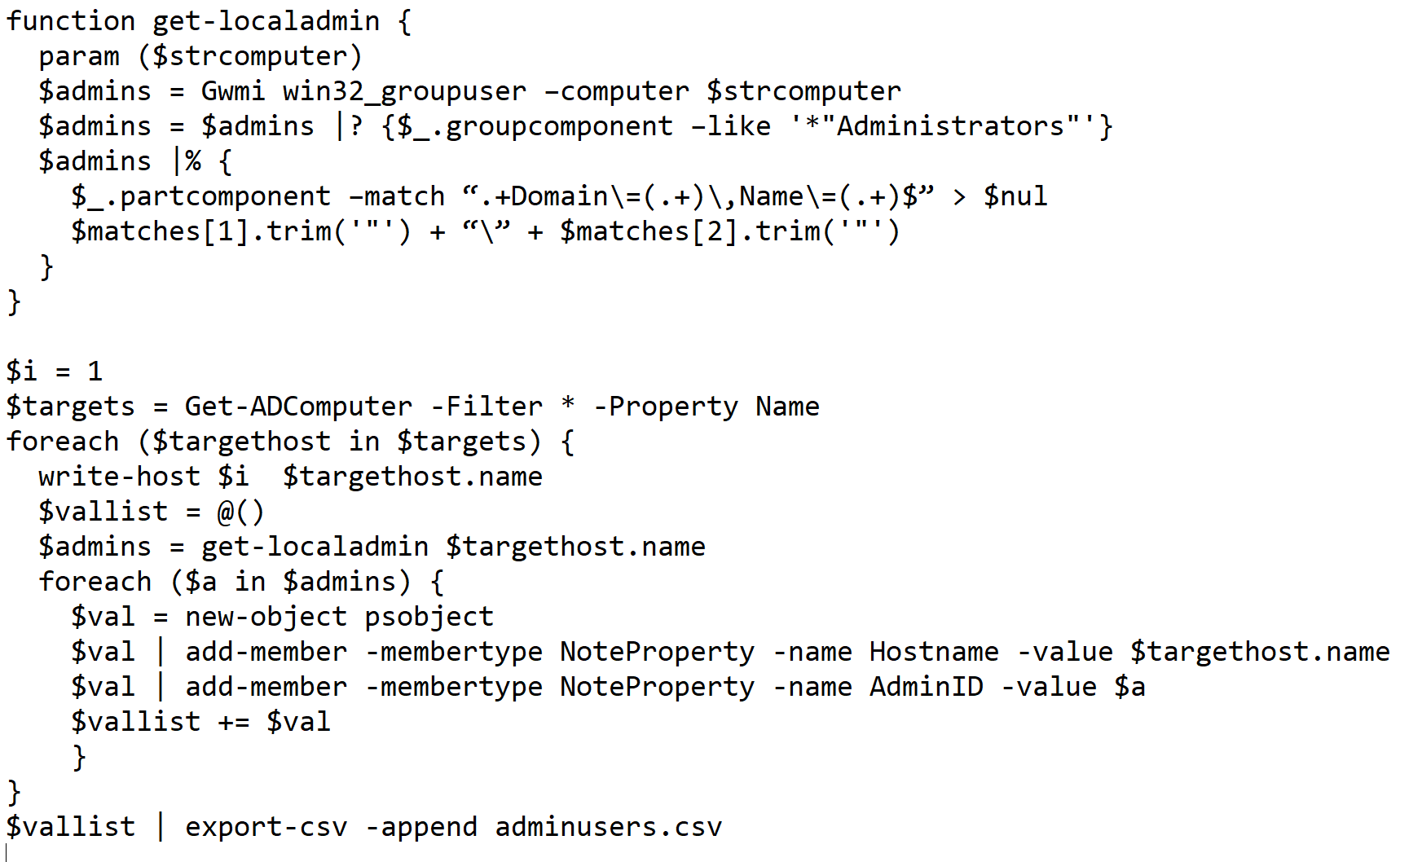
CC4 – Admin Rights / CC 16-Account Monitoring
Got Local Admins?

Slide 22
CC4 – Admin Rights / CC 16-Account Monitoring
Got Dead Accounts?
Password Policy Exceptions?
Legacy Group Members?
Other “Problem Accounts”?
$probusers = get-aduser -filter * -properties * | select samaccountname, name, enabled, scriptpath, passwordlastset, passwordexpired, passwordneverexpires, passwordnotrequired, lockedout, lastlogon, lastlogondate, lastlogontimestamp, lockedout, cannotchangepassword, accountexpirationdate, mobilephone, officephone, telephoneNumber
$probusers | export-csv accountinfo.csv

Slide 23
CC4 – Admin Rights / CC 16 -Account Monitoring
Microsoft Service Accounts:
LocalSystem
NT AUTHORITY\LocalService
NT AUTHORITY\NetworkService
No passwords, so cannot be used by malware or attackers for lateral movement
No interactive session access
Service account password hashes can be extracted directly from the registry (using nishang for instance), or Kerberoasted (look for SPN)

Slide 24
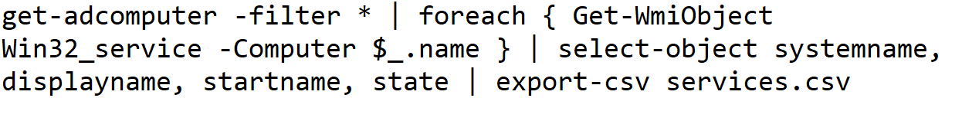
CC4 – Admin Rights / CC 16-Account Monitoring
Got Service Accounts?
(“startname” is the account that starts the service)
Filter out the “good” lines to find the problematic ones
“long tail analysis” to find outliers (sort /count, look at 1’s and 2’s)
Use the “offenders list” to contact vendors, fix configs, or find better products (or find malicious services)

Slide 25
CC 16 - Account Monitoring / CC6 – Log Monitoring
Logging should detect common “lateral movement” scenarious:
Single credentials connecting to multiple stations – esp Local Admin / Domain Admin
be sure to account for admin scripts and helpdesk)
Service Accounts (if they exist) shouldn’t be logging in interactively
A good job for your SIEM
Microsoft LAPS makes a great defense here!
Sets Unique Local Admin passwords, change periodically
Careful though, security tools like LAPS can also be attacked
Also be sure not to LAPS your DCs!

Slide 26
CC 9 – Limit and Control Network Ports
Should define workstation Firewall rules in GPO
Only “trusted hosts” need tcp/445 or tcp/3389 to workstations
Should do the same for Servers
Ditto, nobody needs to map a drive to your SQL Server
Powershell Audit of Firewall State:
Firewall Rules:
Get-NetFirewallProfile -PolicyStore activestore | select name, enabled, defaultinboundaction, DefaultOutboundAction
get-NetFirewallRule -policystore activestore

Slide 27
CC 9 – Limit and Control Network Ports
Should also expand access controls to infrastructure
Access Classes on network gear are easily done but seldom seen
ACLs to prevent access to vCenter, BMC, iLo, SAN Admin etc
Your receptionist does not need access to vCenter, but for some reason they all seem to have it
Neither does your Guest Wireless SSID

Slide 28
Next Steps?
Many of the other Critical Controls can be implemented using Group Policies (also $free)
Others such as implementing 802.1x require other MS components, but are still free
Look for a “Part 2” to this presentation outlining these
Budget dollars are often attached to:
Many (but not all) of the Foundational Controls - Browser and Email protections, Malware defenses etc
Almost all of the Organizational Controls - with the exception of “getting started” phases of User Education

Slide 29
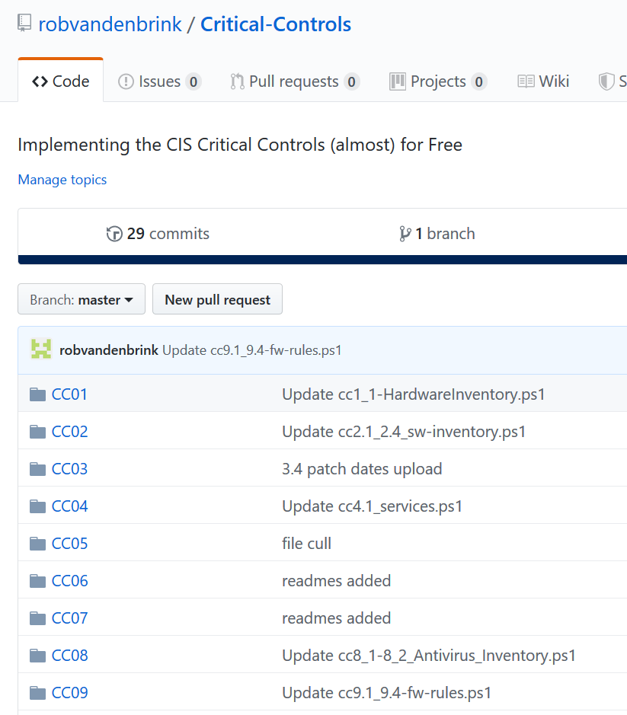
Blogs and Software Repo
Repo: https://github.com/robvandenbrink/Critical-Controls
All scripts and supporting blog links
Watch for new content at https://isc.sans.edu

Slide 30


Questions?
Repo: https://github.com/ robvandenbrink/Critical-Controls
Blog: https://isc.sans.edu
https://www.coherentsecurity.com

